Slide 1
ECE 162B
Lecture 2
Crystal Bonding 1

Slide 2
Crystal Bonding - Intro
Reading: Chapter 5 (Solymar and Walsh)
http://www.ece.ucsb.edu/courses/ECE162/162B_W11DenBaars/default.html
Bonding ⇒ Band structure ⇒ Doping ⇒ Devices
Simplest atom is hydrogen atom
  1 electron + 1 proton
  Recall: system seeks to find minimum energy
  Balance between attractive and repulsive forces
How about ionized atoms (e.g. – Na⁺ and Cl⁻)?
  System also seeks to find minimum energy
  Crystal bonding

Slide 3
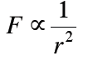
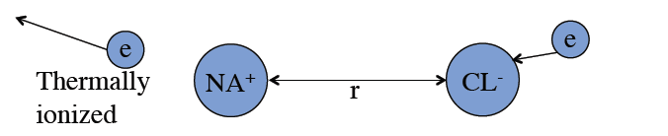
Attractive vs. Repulsive Forces
Attractive force: Coulomb force (e.g. - Na⁺ and Cl⁻)
Bond formed with well defined atomic spacing (0.28 nm)
Why is spacing not zero?
Pauli exclusion principle:
  States that no two identical fermions (e.g. electrons) may simultaneously occupy the same quantum state.
  When two fermions with the same quantum states are brought together, they experience a repulsive force known as Pauli repulsion.
Notes:
Pauli exclusion when inter-atomic distances become comparable with atomic radii. Electrons must be elevated to higher energies to satisfy exclusion principle, which in turn forces further separation between the ions in order to maintain minimum overall energy. This is different from the case of a single atom, where the stability is governed by the uncertainty principle (i.e. – as an electron is moved closer to the nucleus and localized it’s kinetic energy must increase), which causes a repulsive force.

Slide 4
Qualitative Properties of Bonding
Energy tends to zero at large distances (zero energy in the absence of interaction)
At large distances energy is negative and increases with increasing distance. From infinity to r₀ the atoms are attracted to each other.
At very small distances, energy rises rapidly and atoms repel each other.
Curve has a minimum where attractive and repulsive forces balance each other.
We can use these properties to construct a curve of Energy vs. Separation

Slide 5
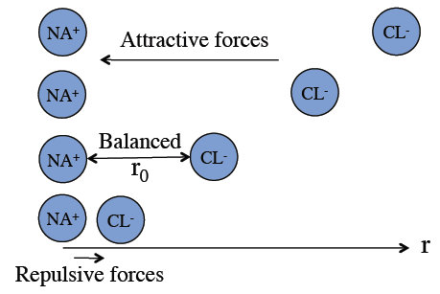
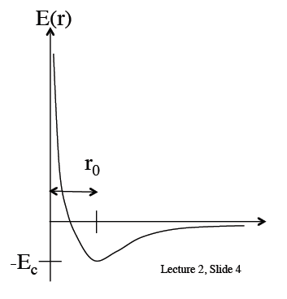
Energy vs. Distance
At equilibrium, attractive forces and repulsive forces are balanced
r₀ is the inter-atomic distance at equilibrium
E_{c} is the bond energy (cohesive energy)
r
Notes:
Annotate diagram with Coulomb and Pauli zones. Annotate diagram with notes from NaCl bonding and explain when it becomes energetically favorable for the electron to transfer from Na to Cl

Slide 6
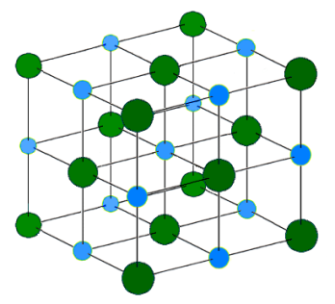
Crystals
Atoms will organize into crystalline solids and will be stable if the total crystal energy is lower than the total energy of the free atoms or molecules
Cohesive energy = free atom energy – crystal energy
  Amount of energy required to break the crystal into it’s constituent atoms
  Semiconductors typically have large cohesive energies, metals typically have small cohesive energies
The behavior of crystalline solids is well described by our model
  If we compress the crystal, the atoms will resist and the energy will increase
  If we remove the compression, the atoms will return to equilibrium
We can define the elastic properties of the solid in terms of its response to an externally applied force
simple cubic NaCl
Notes:
Large cohesive energy means solid is strongly bound and mechanically stable.

Slide 7
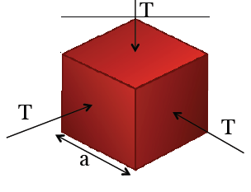
Bulk Elastic Constant of a Solid
**See class notes for details of the following derivation
Consider a cubic piece of material, density of atoms per volume N_{a}, and energy per atom E(r₀)
What is the energy change under isotropic compression (equal force from all sides)?
A cube of linear dimension a, uniformly compressed by stress T applied to all 6 sides will have a net increase in energy of:
Eqn. (1)

Slide 8
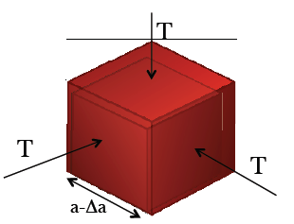
Bulk Elastic Constant of a Solid
The increase in energy is equivalent to the work performed moving all six sides of the cube
Each face is compressed by:
The total work done compressing the cube is:
Total work done equals the total change in energy so we equate equations (1) and (2) and can solve for the stress:
Eqn. (2)
Eqn. (3)

Slide 9
Bulk Elastic Constant of a Solid
Define bulk elastic modulus:
Equating (3) and the above expression we can solve for the bulk elastic constant, c
We have obtained a form of Hooke’s law and the bulk elastic constant by analyzing the interaction of atoms

Slide 10
Minimum Energy
We can obtain an expression for the minimum energy (E_{c}) by approximating the curve E(r) by:
Differentiate with respect to r and set equal to 0
We can obtain the following expression (see class notes for derivation):
r
repulsion
attraction
For a stable bond, E(r₀) must be negative ⇒ m<n

Slide 11
Bond Types
Ionic bonds - NaCl
Metallic bonds – Cu, Zn
Covalent bonds – C, Si, Ge, GaAs
Van der Waals bond – Ne, Ar

Slide 12
Ionic Bonds
Electrons are exchanged, non-metal and metal ion
NaCl is the simplest example
  Na⁺ - positive ion
  Cl⁻ - negative ion
  Simple cubic
How much energy would it take to pull this crystal apart (what is the cohesive energy, E_{c})?
Binding energy mainly due to electrostatic forces, so we can sum the energy from these forces
Na⁺
Cl⁻
a

Slide 13
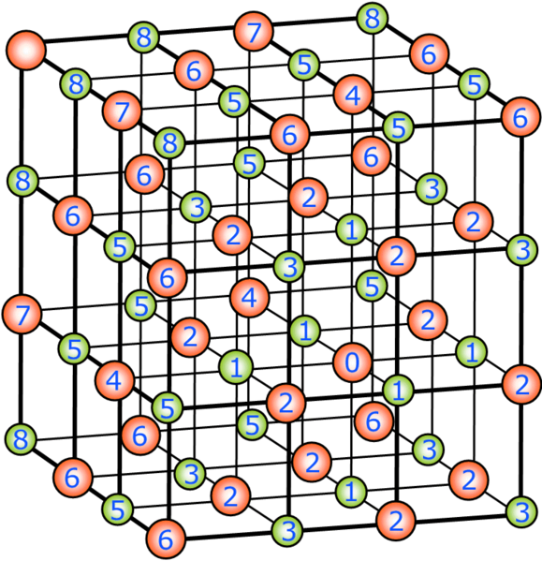
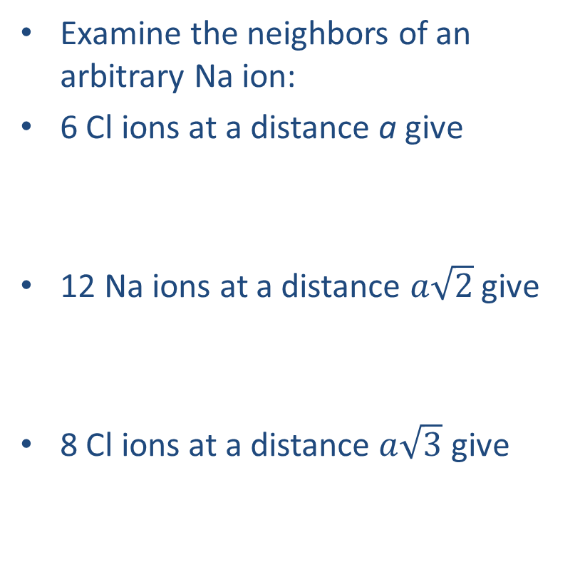
Ionic Bonds
Examine the neighbors of an arbitrary Na ion:
6 Cl ions at a distance a give
12 Na ions at a distance $a\sqrt{2}$give
8 Cl ions at a distance $a\sqrt{3}$ give
Na⁺
Cl⁻
a

Slide 14
Ionic Bonds
The total energy becomes:
Example: line of ions
M = Madelung constant
= 1.748 for simple cubic
-
+
-
+
-
+
-
+
R
x = 1 in our series and we have

Slide 15
Ionic Bonds
The more nearest neighbors of opposite charge the higher the Madelung constant
  Zinc blende (ZnS) = 1.6381 (coordination number = 4)
  SC (NaCl) = 1.7476 (coordination number = 6)
  BCC (CeCl) = 1.7627 (coordination number = 8)
For NaCl, using a = 0.28nm and M = 1.748 we calculate a cohesion energy of -8.94eV
  ~10% off from experimental value
  There are other forces involved aside from electrostatic forces

Slide 16
Metallic Bonds
Every atom in a metal donates one or more electrons and then become a lattice ions
  The electrons move around and scatter off each other and the fixed lattice ions
  They form an “electron sea”, whose electrostatic attraction holds together the positive lattice ions
  Electrons are confined to the metal so we have to do work to remove them
  The electrostatic attraction comes from all directions, so the bond is non-directional
  Metals are ductile and malleable

Slide 17
Covalent Bonds
Also known as valance bonds
Sharing of electrons between atoms (but truly described by quantum mechanics)
In general these bond are very strong (e.g. – C in diamond form is hardest known substance)
Simple example is the hydrogen molecule
  Two protons are held together by two electrons
  Atoms desire to fill 1s shell with two electrons, so they share
  Electrons are of opposite spins (Pauli exclusion principle)
Another example is Cl, which has 5 electrons in it’s 3p shell

Slide 18
Covalent Bonds
Electron configurations for atoms that form covalent bonds:
  C: 1s², 2s², 2p²
  Si: 1s², 2s², 2p⁶, 3s², 3p²
  Ge: 1s², 2s², 2p⁶, 3s², 3p⁶, 3d¹⁰, 4s², 4p²
Common feature is there are 2 s and 2 p electrons in the outer shell
  Atoms seem to be divalent (2 valance electrons) but when they interact the symmetry of the outer s-electrons is broken and minimum energy state is for them to join the p-electrons and the atoms become tetravalent (4 valance electrons)
  For bonding, atoms can be visualized as having four dangling electrons
In some material systems (e.g. – compound) the covalent bond is more easily broken and the electrons freed by breaking this bond can conduct
  Semiconductors

Slide 19
Van der Waals Bonds
What happens when we have an electrically neutral atom (not ionized) and there are no electrostatic forces (e.g. – Ar)
How do neutral atoms form bonds?
Electron position is described by probability density and its location fluctuates in time, forming a displacement between the electron and the nucleus ⇒ oscillating dipole
One dipole will induce and opposite dipole on neighboring atoms
The tendency on average of these dipoles is for them to attract ⇒ Van der Waals force
Forces are weak – these materials have low melting and boiling points

Slide 20
Questions
Questions during and after class:
  Are free electrons from broken covalent bonds? A dopant forms a covalent bond by sharing its electrons with the lattice. The extra electron is still covalently bonded but with low energy required to break the bond. So, yes, in a sense free electrons in semiconductors are from broken covalent bonds.
  How do we get:
  Will the derivation of the bulk elastic constant change if the crystal structure changes (e.g. – is FCC different than BCC or SC)? Yes, I believe. The example is for isotropic compression of a simple cubic where the spacing between atoms is the same in all directions and the spacing undergoes equal change in each direction. Need to look into this more…

